Slide 1
Planning
CMSC 471

Slide 2
Blocks World Planning
A
C
B
A
B
C

Slide 3
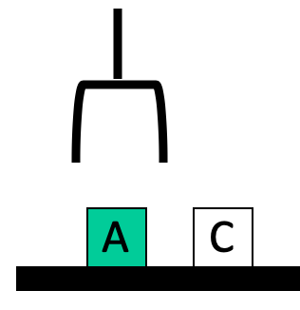
Blocks world
The blocks world is a micro-world with a table, a set of blocks, and a robot hand
Some constraints for a simple model:
Only one block can be on another block
Any number of blocks can be on the table
The hand can only hold one block
Typical representation uses a logic notation:
ontable(b) ontable(d)
on(c,d) holding(a)
clear(b) clear(c)

Slide 4
Typical BW planning problem
Initial state:
clear(a)
clear(b)
clear(c)
ontable(a)
ontable(b)
ontable(c)
handempty
Goal:
on(b,c)
on(a,b)
ontable(c)
A
C
B
A
B
C

Slide 5
Typical BW planning problem
Logical assertions describing initial & final states
Sequence of robot actions
Initial state:
clear(a)
clear(b)
clear(c)
ontable(a)
ontable(b)
ontable(c)
handempty
Goal state:
on(b,c)
on(a,b)
ontable(c)
Plan:
pickup(b)
stack(b,c)
pickup(a)
stack(a,b)
A
C
B
A
B
C

Slide 6
Planning problem
Find sequence of actions to achieve goal state when executed from initial state given
set of possible primitive actions, including their preconditions and effects
initial state description
goal state description
Compute plan as a sequence of actions that, when executed in initial state, achieves goal state
States specified as a KB , i.e. conjunction of conditions
e.g., ontable(a) ∧ on(b, a)

Slide 7
Planning vs. problem solving
Problem solving methods can solve similar problems
Planning is more powerful and efficient because of the representations and methods used
States, goals, and actions are decomposed into sets of sentences (usually in first-order logic)
Search often proceeds through plan space rather than state space (though there are also state-space planners)
Sub-goals can be planned independently, reducing the complexity of the planning problem

Slide 8
Typical simplifying assumptions
Atomic time: Each action is indivisible
No concurrent actions: but actions need not be ordered w.r.t. each other in the plan
Deterministic actions: action results completely determined — no uncertainty in their effects
Agent is the sole cause of change in the world
Agent is omniscient with complete knowledge of the state of the world
Closed world assumption: everything known to be true in world is included in state description and anything not listed is false

Slide 9
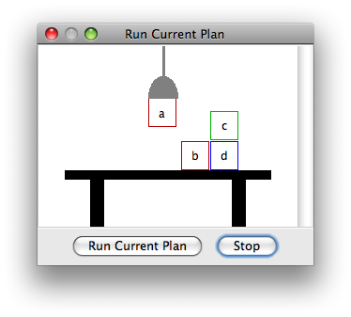
Blocks world
The blocks world consists of a table, a set of blocks and a robot hand
Some domain constraints:
Only one block can be on another block
Any number of blocks can be on the table
The hand can only hold one block
Typical representation:
ontable(b) ontable(d)
on(c,d) holding(a)
clear(b) clear(c)
Meant to be a simple model!

Slide 10
Typical BW planning problem
Initial state:
clear(a)
clear(b)
clear(c)
ontable(a)
ontable(b)
ontable(c)
handempty
Goal:
on(b,c)
on(a,b)
ontable(c)
A plan:
pickup(b)
stack(b,c)
pickup(a)
stack(a,b)
A
C
B
A
B
C

Slide 11
Typical BW planning problem
Initial state:
clear(a)
clear(b)
clear(c)
ontable(a)
ontable(b)
ontable(c)
handempty
Goal:
on(a,b)
on(b,c)
ontable(c)
A plan:
pickup(a)
stack(a,b)
unstack(a,b)
putdown(a)
pickup(b)
stack(b,c)
pickup(a)
stack(a,b)
A
C
B
A
B
C

Slide 12
Typical BW planning problem
Initial state:
clear(a)
clear(b)
clear(c)
ontable(a)
ontable(b)
ontable(c)
handempty
Goal:
on(a,b)
on(b,c)
ontable(c)
A plan:
pickup(a)
stack(a,b)
unstack(a,b)
putdown(a)
pickup(b)
stack(b,c)
pickup(a)
stack(a,b)
A
C
B
A
B
C
Note: Goals in a different order!

Slide 13
Typical BW planning problem
Plan:
unstack(c,b)
putdown(c)
unstack(b,a)
putdown(b)
pickup(a)
stack(a,b)
unstack(a,b)
putdown(a)
pickup(b)
stack(b,c)
pickup(a)
stack(a,b)
Initial state:
clear(c)
ontable(a)
on(b,a)
on(c,b)
handempty
Goal:
on(a,b)
on(b,c)
ontable(c)
C
B
A
A
B
C
Note: not very efficient!

Slide 14
Major approaches
Planning as search
GPS / STRIPS
Situation calculus
Partial order planning
Hierarchical decomposition (HTN planning)
Planning with constraints (SATplan, Graphplan)
Reactive planning

Slide 15
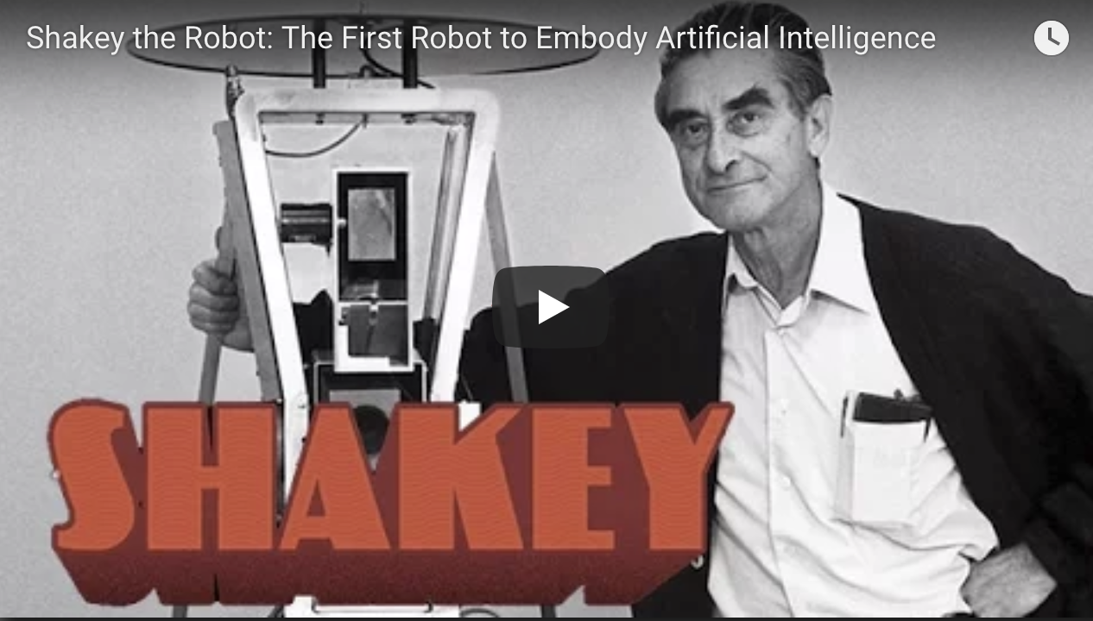

Shakey the robot
First general-purpose mobile robot to be able to reason about its own actions
Shakey the Robot: 1st Robot to Embody Artificial Intelli-gence (2017, 6 min.)
Shakey: Experiments in Robot Planning and Learning (1972, 24 min)

Slide 16
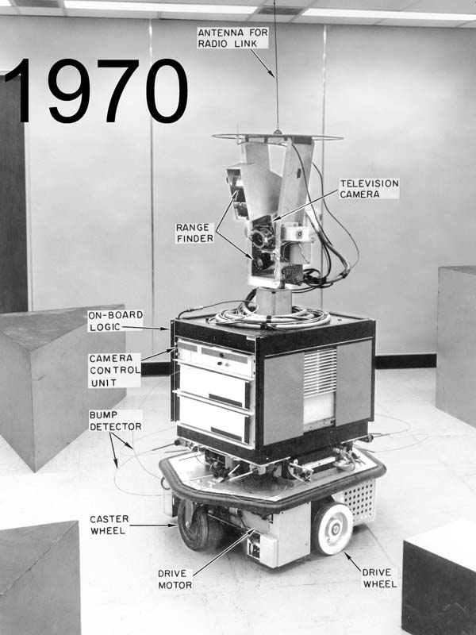
Strips planning representation
Classic approach first used in the STRIPS (Stanford Research Institute Problem Solver) planner
A State is a conjunction of ground literals
at(Home) ∧ ¬have(Milk) ∧ ¬have(bananas) ...
Goals are conjunctions of literals, but may have variables, assumed to be existentially quantified
at(?x) ∧ have(Milk) ∧ have(bananas) ...
Need not fully specify state
Non-specified conditions either don’t-care or assumed false
Represent many cases in small storage
May only represent changes in state rather than entire situation
Unlike theorem prover, not seeking whether goal is true, but is there a sequence of actions to attain it
Shakey the robot

Slide 17
Blocks world operators
Classic basic operations for the blocks world
stack(X,Y): put block X on block Y
unstack(X,Y): remove block X from block Y
pickup(X): pickup block X
putdown(X): put block X on the table
Each represented by
list of preconditions
list of new facts to be added (add-effects)
list of facts to be removed (delete-effects)
optionally, set of (simple) variable constraints
For example stack(X,Y):
preconditions(stack(X,Y), [holding(X), clear(Y)])
deletes(stack(X,Y), [holding(X), clear(Y)]).
adds(stack(X,Y), [handempty, on(X,Y), clear(X)])
constraints(stack(X,Y), [X≠Y, Y≠table, X≠table])

Slide 18
STRIPS planning
STRIPS maintains two additional data structures:
State List - all currently true predicates.
Goal Stack - push down stack of goals to be solved, with current goal on top
If current goal not satisfied by present state, find action that adds it and push action and its preconditions (subgoals) on stack
When a current goal is satisfied, POP from stack
When an action is on top stack, record its application on plan sequence and use its add and delete lists to update current state

Slide 19
Typical BW planning problem
Initial state:
clear(a)
clear(b)
clear(c)
ontable(a)
ontable(b)
ontable(c)
handempty
Goal:
on(b,c)
on(a,b)
ontable(c)
A plan:
pickup(b)
stack(b,c)
pickup(a)
stack(a,b)
A
C
B
A
B
C

Slide 20
Typical BW planning problem
Initial state:
clear(a)
clear(b)
clear(c)
ontable(a)
ontable(b)
ontable(c)
handempty
Goal:
on(a,b)
on(b,c)
ontable(c)
A plan:
pickup(a)
stack(a,b)
unstack(a,b)
putdown(a)
pickup(b)
stack(b,c)
pickup(a)
stack(a,b)
A
C
B
A
B
C

Slide 21
Typical BW planning problem
Plan:
unstack(c,b)
putdown(c)
unstack(b,a)
putdown(b)
pickup(b)
stack(b,a)
unstack(b,a)
putdown(b)
pickup(a)
stack(a,b)
unstack(a,b)
putdown(a)
pickup(b)
stack(b,c)
pickup(a)
stack(a,b)
Initial state:
clear(c)
ontable(a)
on(b,a)
on(c,b)
handempty
Goal:
on(a,b)
on(b,c)
ontable(c)
C
B
A
A
B
C

Slide 22
Typical BW planning problem
Initial state:
ontable(a)
ontable(b)
clear(a)
clear(b)
handempty
Goal:
on(a,b)
on(b,a)
Plan:
??
A
B

Slide 23
Goal interaction
Simple planning algorithms assume independent sub-goals
Solve each separately and concatenate the solutions
The “Sussman Anomaly” is the classic example of the goal interaction problem:
Solving on(A,B) first (via unstack(C,A), stack(A,B)) is undone when solving 2nd goal on(B,C) (via unstack(A,B), stack(B,C))
Solving on(B,C) first will be undone when solving on(A,B)
Classic STRIPS couldn’t handle this, although minor modifications can get it to do simple cases
A
C
B
A
B
C
Initial state
Goal state

Slide 24
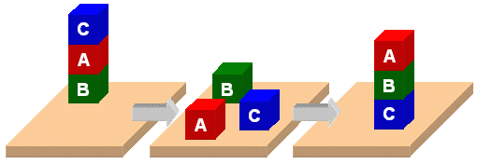
PDDL

Slide 25
PDDL
Planning Domain Description Language
Based on STRIPS with various extensions
First defined by Drew McDermott (Yale) et al.
Classic spec: PDDL 1.2; good reference guide
Used in biennial International Planning Competition (IPC) series (1998-2020)
Many planners use it as a standard input

Slide 26
PDDL Representation
Task specified via two files: domain file and problem file
Both use a logic-oriented notation with Lisp syntax
Domain file defines a domain via requirements, predicates, constants, and actions
Used for many different problem files
Problem file: defines problem by describing its domain, objects, initial state and goal state
Planner: takes a domain and a problem and produces a plan

Slide 27

Blocks Word Domain File
(define (domain BW)
(:requirements :strips)
(:constants red green blue yellow small large)
(:predicates (on ?x ?y) (on-table ?x) (color ?x ?y) … (clear ?x))
(:action pick-up
:parameters (?obj1)
:precondition (and (clear ?obj1) (on-table ?obj1) (arm-empty))
:effect (and (not (on-table ?obj1))
(not (clear ?obj1))
(not (arm-empty))
(holding ?obj1)))
… more actions ...)

Slide 28
Blocks Word Problem File
(define (problem 00)
(:domain BW)
(:objects A B C)
(:init (arm-empty)
(on B A)
(on C B)
(clear C))
(:goal (and (on A B)
(on B C))))
C
A
B
B
A
C

Slide 29
Blocks Word Problem File
C
A
(define (problem 00)
(:domain BW)
(:objects A B C)
(:init (arm-empty)
(on B A)
(on C B)
(clear C))
(:goal (and (on A B)
(on B C))))
B
B
A
C
Begin plan
1 (unstack c b)
2 (put-down c)
3 (unstack b a)
4 (stack b c)
5 (pick-up a)
6 (stack a b)
End plan

Slide 30
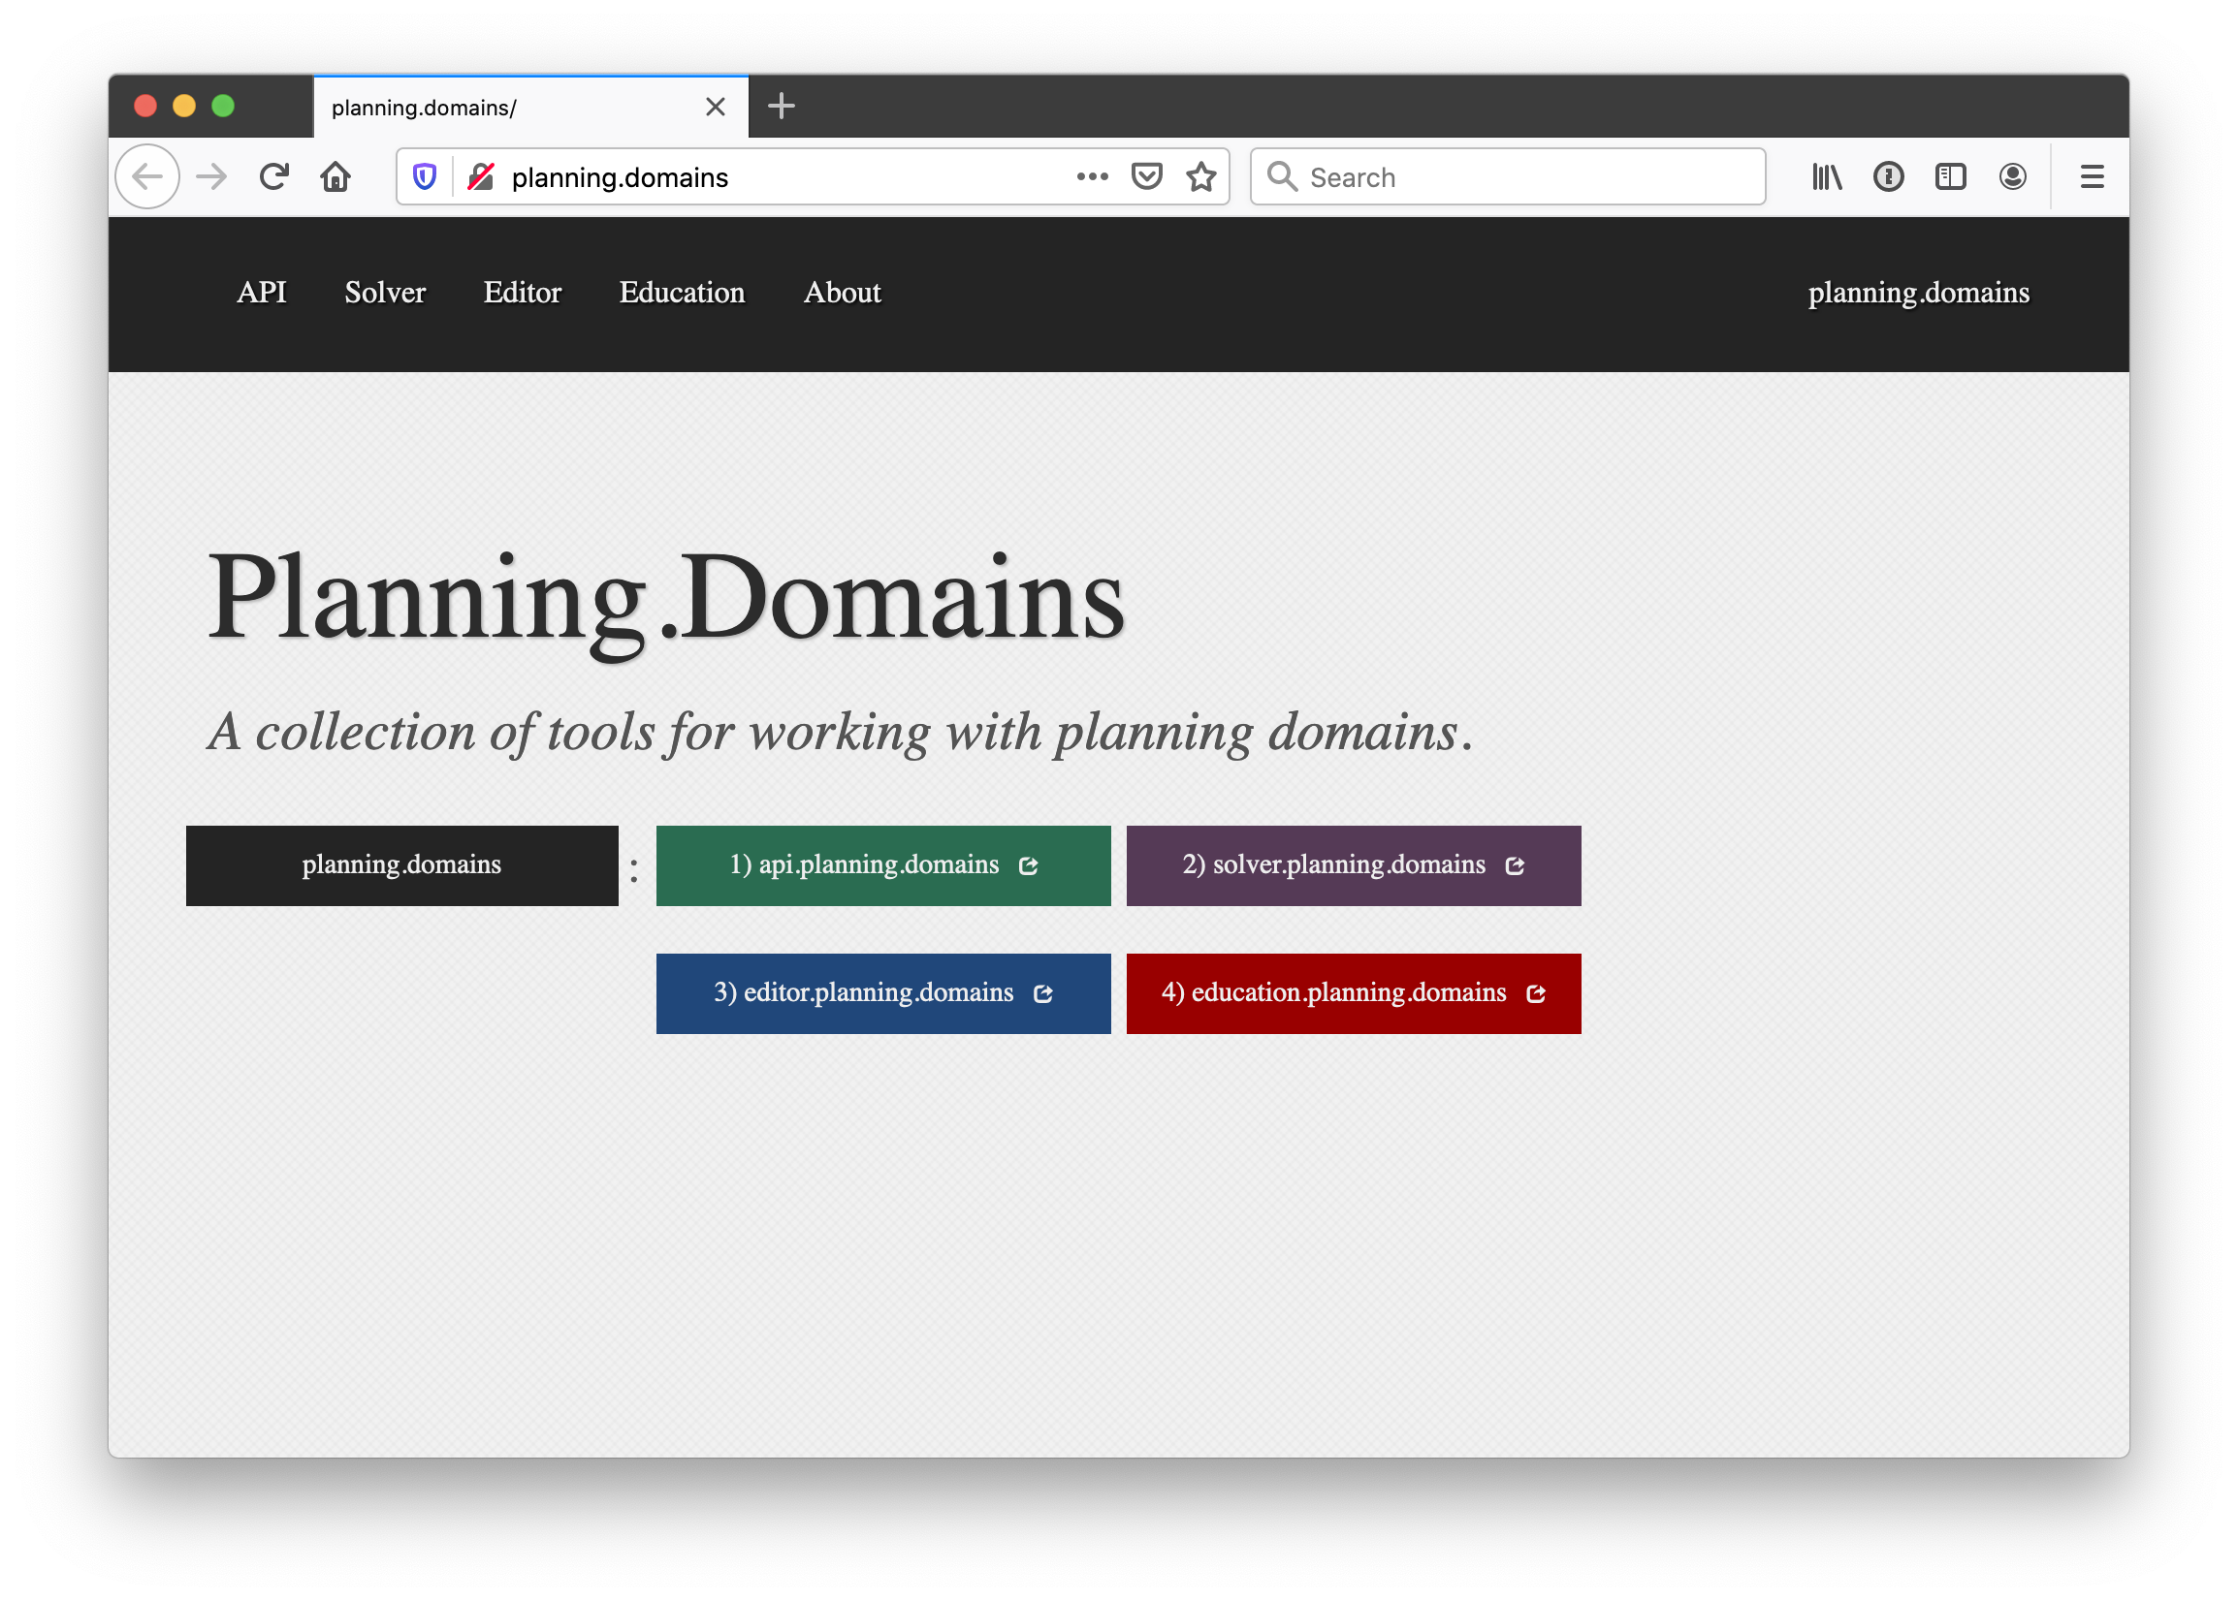
http://planning.domains/

Slide 31
Planning.domains
Open source environment for providing planning services using PDDL (GitHub)
Default planner is ff
very successful forward-chaining heuristic search planner producing sequential plans
Can be configured to work with other planners
Use interactively or call via web-based API

